Slide 1
301, Nov 7, Class 23
Chapter 14: Surveys and Instruments research
  Building operational definitions by self-completed ratings

Slide 2
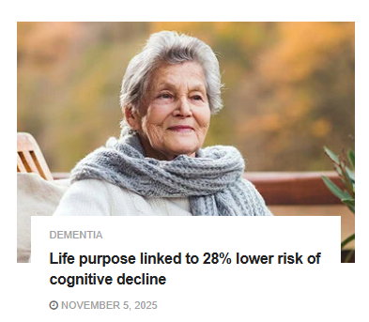
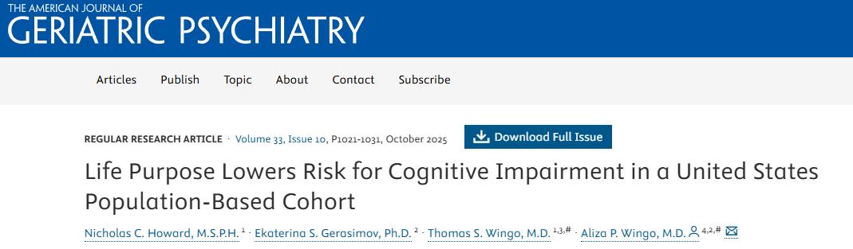

Slide 3
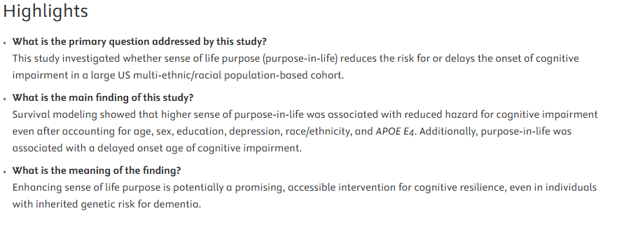
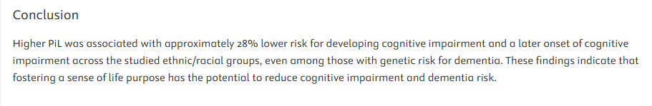

Slide 4
Purpose in Life (PIL) Scale
My life seems most worthwhile
I feel my life has a sense of meaning
My personal existence is full of purpose
There are things I still want to achieve in my life
My personal existence is full of direction
There is no purpose in what I am doing*
I feel my life has a sense of direction
I feel my life is going nowhere*
I feel my life has a sense of purpose
There is no meaning to my life*
My personal existence is full of meaning
My life has clear goals and aims
Rate each on 1 to 5 scale
  Agree strongly
  Agree
  Not certain
  Disagree
  Disagree strongly

Slide 5
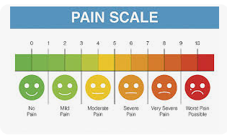
Pain
How much pain are you in
right now?
How does this measured operational definition of pain differ from the Mythbusters episode?

Slide 6
Surveys & Instrument Design
Survey
  Series of questions, often with a simple numerical response scale
  Often used in non-experimental research
  Relationships among responses used for sociology, economics, epidemiology
Instrument
  Established series of questions to quantify a construct
    Described and evaluated in peer-reviewed publications
  Example operational definitions
    Depression
    Personality measures
    IQ

Slide 7
Survey research
Quality and effectiveness of questions
  Demand characteristics
  Complex or double-barreled questions
Sampling methodology
  Recruiting bias
  Participation/Non-response bias
  Inaccurate responses

Slide 8
Bias
1. What is meant by “selection bias” in the context of survey research?
  a. The survey participants are not randomly chosen from the population.
  b. The survey participants are randomly chosen from the population.
  c. The survey participants are not part of the population of interest.
  d. The survey participants are a part of the population of interest.

Slide 9
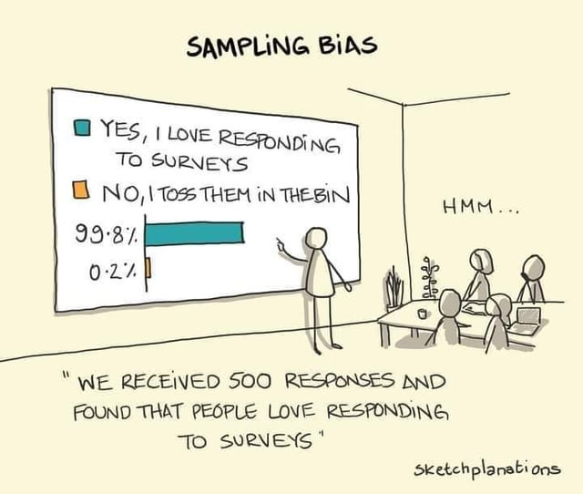
2. Which bias occurs when individuals who were contacted chose to complete the survey differ in some ways from others who were contacted but chose not to take the survey?
  a. Response set
  b. Non-response
  c. Attrition
  d. Motivated respondent

Slide 10
Explain how each of the following two questions are examples of “double-barreled” questions:
  Please agree or disagree with the following statement: Cars should be faster and safer.
  How satisfied are you with your pay and job conditions?

Slide 11
Instrument development
Reliability measures
  Test-retest reliability: for measures that are hypothesized to be stable over time
  Inter-item reliability: statistical tools for assessing relationships among items supposed to tap the same constructs
Validity measures
  Construct/Face validity
  Convergent validity with existing measures
  Discriminant validity versus existing measures

Slide 12
Writing Effective Questions
BRUSO
  Brief
  Relevant
  Unambiguous
  Specific
  Objective

Slide 13
4. Write example survey items for each of the following general questions. In some cases, a series of items, rather than a single item, might be necessary.
How much does the respondent use Facebook?
How much exercise does the respondent get?
How likely does the respondent think it is that the incumbent will be re-elected in the next presidential election?
To what extent does the respondent experience “road rage”?

Slide 14
How Happy Are You Right Now?
How do we turn happiness into a number?
  Creating an assessment that carries out this operational definition

Slide 15
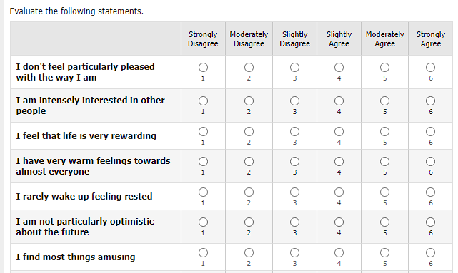
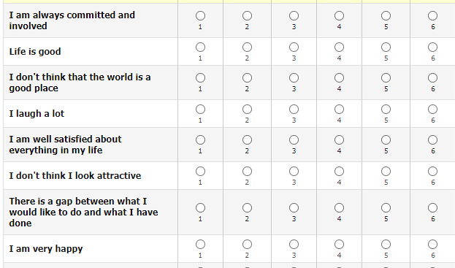
OHQ online survey

Slide 16
Oxford Happiness Questionnaire
INSTRUCTIONS. Below are a number of statements about happiness. Would you please indicate how much you agree or disagree with each by entering a number alongside it according to the following code:
1=strongly disagree; 2=moderately disagree; 3=slightly disagree; 4=slightly agree; 5=moderately agree; 6=strongly agree.
  I feel that life is very rewarding
  I am well satisfied about everything in my life
  I don't feel particularly pleased with the way I am (−)

Slide 17
Using an existing scale
Follow the directions in the publication that describes and establishes scale validity
Note varieties: 29 items or 8 (short form)
Use all items in form selected
  Following scoring procedure
  Flip reverse items
  Usually sum, sometimes weighting
Hills, P., & Argyle, M. (2002). The Oxford Happiness Questionnaire: a compact scale for the measurement of psychological well-being. Personality and individual differences, 33(7), 1073-1082.

Slide 18
For Mon 11/10
Chapter 15, Statistics 3
  Correlation analysis
  Chi2 analysis
Final Projects
  Start your Methods description on Canvas by Tuesday 11/11

Slide 19
Project reviews, 10am (Section 20)
Retrieval practice
  Avery, Andrew, Tobey
Reward and competition
  Pritika, Lauren, Kara
Trustworthiness
  Abby, Harper, Hillary
Anchoring
  Arawen, Jonathan, Megan
Effort Heuristic
  Hannah, Barbara, Ludia, Maddie
Font legibility
  Salma, Clarissa

Slide 20
Project Reviews 2pm (Section 21)
Magenta
  Annelise, Leanna, Dora, Keegan
  Social media and prosocial behavior
Periwinkle
  Hanna, Marcos, Chris
  Task difficulty and memory
Turquoise
  Abby, Rafe, Frank
  Perceptual disfluency and insight

